Slide 1
Bias-Variance Trade-Off

Slide 2

Three Fundamental Quantities
Expected test MSE:
Variance of $\hat{f}(x_{0})$
Squared Bias of of $\hat{f}(x_{0})$
Variance of the error term ϵ

Slide 3

Variance
It measures how far a set of random variables are spread out from their mean.
You can expect that a high variance means that your estimated function varies a lot depending on the data set that you give.
Variance equation:

Slide 4
Bias
Determine if the expected value of the results differs from the true underlying quantitative parameter being estimated.
Bias of an estimator is the difference between this estimator’s expected value and the true value of the parameter being estimated.
To find the bias of a function:
perform many estimates
add up the errors in each estimate compared to the real value.
dividing by the number of estimates gives the bias of the function.

Slide 5
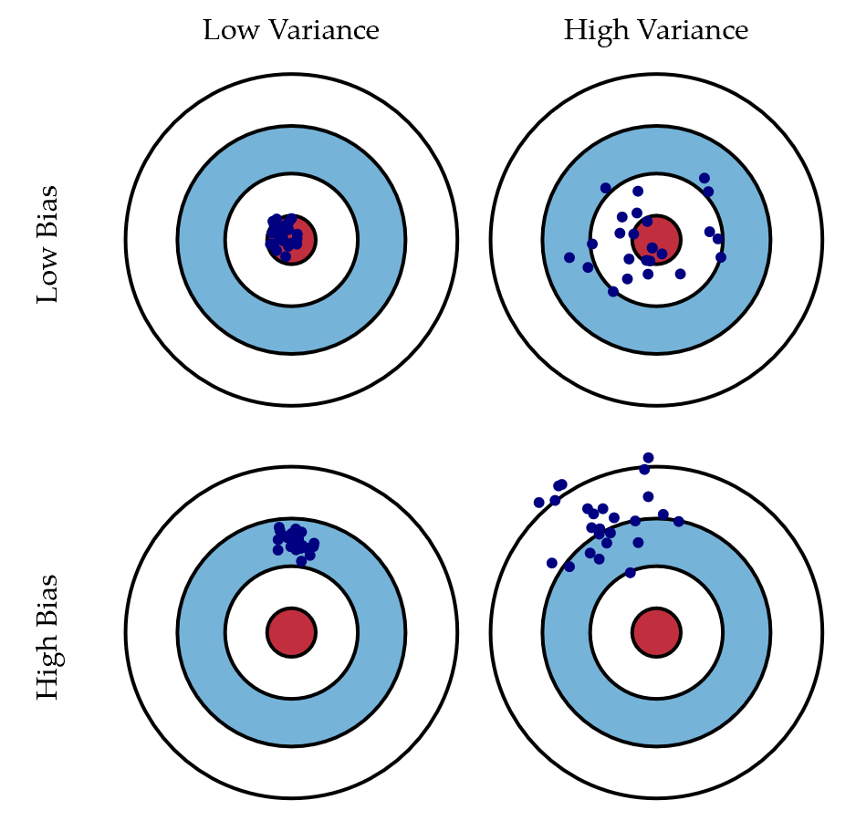
Graphic Visual of Bias and Variance

Slide 6
Trade-Off
In general, increasing the complexity of the function, the bias of the function decrease while variance increase.
Bias and Variance are inversely proportional to each other.
Cannot decrease both of them.
This is the basic for bias-variance trade-off.

Slide 7
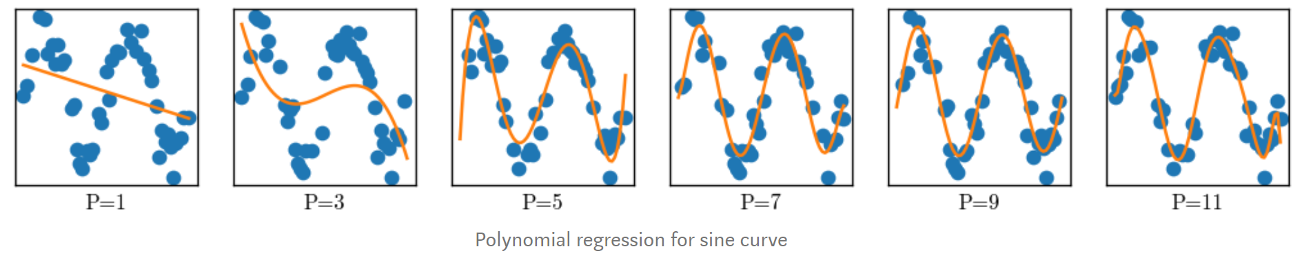
Examples
The above figure shows different polynomial regression for the sine curve.

Slide 8
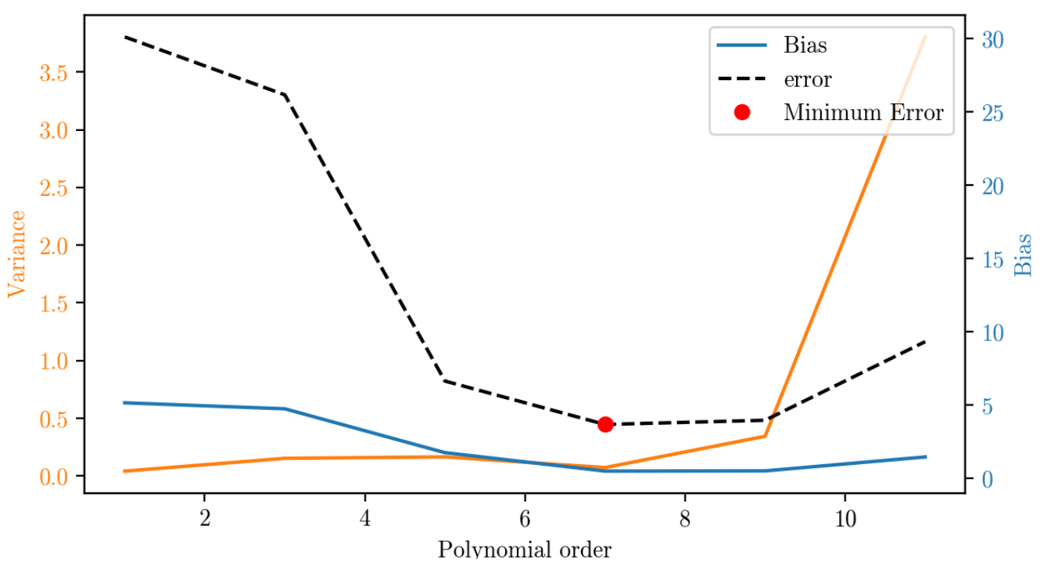

Slide 9
